Slide 1
Tenecteplase for Stroke
Learning Outcomes:
At the completion of this activity, you will be able to:
Review thrombolytic treatment practice change for stroke
Recognize treatment options for stroke
Review how to mix, dose, and administer IV tenecteplase

Slide 2
Tenecteplase for Stroke
Alteplase HAS BEEN the drug we used for treating eligible patients since 1996.
NOW current evidence suggests TENECTEPLASE…
is equivalent to alteplase for treatment of AIS.
is included as an appropriate option for thrombolytic treatment by the ASA.
showed superiority in treatment of large vessel occlusion (LVO) strokes with better recanalization rates.
has equivalent or less bleeding complications compared to alteplase

Slide 3
Tenecteplase for Stroke
Situation: ​
Tenecteplase is included in the most recent American Stroke Association (ASA) guideline update for treatment of eligible acute ischemic stroke (AIS) patients (class IIb, level of evidence B-R). In head-to-head trials, tenecteplase showed noninferiority when compared to alteplase, and superior recanalization rates patients with large vessel occlusions (LVO).​
Through governance, extensive literature review, stroke expert and pharmacy consensus PSJH decided to make the switch to tenecteplase for treating AIS.​

Slide 4
Tenecteplase for Stroke
Background: ​
IV alteplase has been the mainstay treatment recommended by the ASA for treatment of eligible AIS patients since 1996. ​
A growing body of evidence shows superiority of tenecteplase versus alteplase in patients with large vessel occlusion, results in less bleeding complications, and better 90-day outcomes.​
​

Slide 5
Tenecteplase for Stroke
Assessment:​
Tenecteplase is easier to administer than alteplase and only requires a single bolus given over 5 seconds.​
Some hospitals who have made the switch to tenecteplase have seen dramatically faster door-to-needle times. Overall time for the tenecteplase dose to be completed is faster with tenecteplase due to single bolus dosing.
Faster stroke treatment times result in better patient outcomes.​
Tenecteplase for stroke maximum dose is 25mg (5mL), is different than STEMI dosing, and is NOT compatible with IV dextrose.​
​

Slide 6
Tenecteplase for Stroke
Recommendations: ​
Use tenecteplase 0.25mg/kg for treating AIS with a max dose of 25 mg (5mL) for stroke.
Use the same workflow for giving tenecteplase that was used for alteplase:​
BP parameter remains 180/105​
Timeout/dual sign off required
Frequency of VS & Neuro Check/SNAP
Check for bleeding and angioedema

Slide 7
Tenecteplase for Stroke
Key Differences:​ Tenecteplase is NOT compatible with IV dextrose​ | Tenecteplase for Stroke:​ | Compare Alteplase:​
BP parameter​ | < 180/105​ | < 180/105​
Weight-range based dosing​ | ~0.25 mg/kg​ see dosing table | 0.9mg/kg​
Maximum dose​ | 25mg (5ml)​ | 90 mg (9ml bolus)​
Concentration​ | 5mg/mL​ | 1mg/mL​
Half life​ | 20-25 min​ | 5 min​
Pharmacy mix/deliver?​ | Yes​ | Yes​
Timeout/dual sign off?​ | Yes​ | Yes​
Goal door-to-needle​ | 30 min or less​ | 30 min or less​
Bolus administration​ Not compatible with dextrose | Over 5 sec​ Flush before and after with NS | Over 1-2 min​
Infusion post bolus?​ | No, bolus only​ | Yes for 1 hour​
Signs and sx to watch for after administration​ | Bleeding, angioedema, neuro changes​ | Bleeding, angioedema, neuro changes​
SNAP & VS frequency​ | q15min x 2hrs,​ q30min x 6hrs,​ q1hr x 16 hrs​ | q15min x 2hrs, ​ q30min x 6hrs, ​ q1hr x 16 hrs​
Brain bleeding risk​ | Equivalent or less than alteplase²⁻⁵​ | 6%​

Slide 8
The American Stroke Association (ASA) recommends use of a thrombolytic for treatment of acute ischemic stroke (AIS)
Benefit of thrombolytic therapy remains TIME DEPENDENT.
The faster a person is treated, the better their outcome!

Slide 9
Acute Stroke Treatment
If your patient has any signs or symptoms of a stroke activate your hospital’s EMERGENCY RESPONSE process FOR STROKE STAT.
In Emergency Department, triage all stroke and TIA patients as ESI level 2 unless hemodynamically unstable.
Notes:
Work on this more

Slide 10
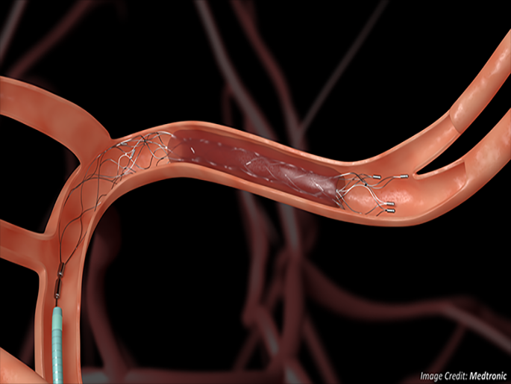
Acute Stroke Treatment
1- Tenecteplase for Stroke
2- Thrombectomy

Slide 11
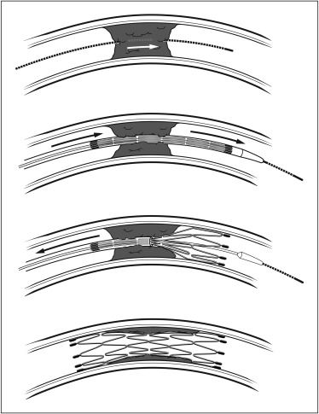
Thrombectomy when there is a Large Vessel Occlusion:
Acute Stroke Treatment
Can be done with or without IV thrombolytic.
Catheter is advanced to the cerebral artery that is occluded and clot is removed!
https://www.sciencedirect.com/science/article/pii/S0010865016000060
Studies show treating large vessel occlusion with thrombectomy up to 24 hours after symptom onset can decrease long term disability.

Slide 12
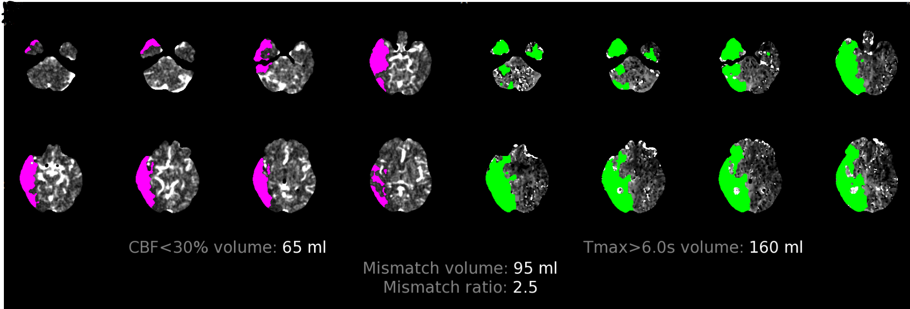
Acute Stroke Treatment
CT Perfusion scan might be done to evaluate for salvageable brain (penumbra) prior to thrombectomy in patients up to 24 hours from last known well time.
Ischemic core
Possibly salvageable penumbra beyond the core infarct.

Slide 13
Acute Stroke Treatment
ABCs & Vitals signs
Glucose
BE FAST exam
STAT CT HEAD!
Ensure CODE STROKE has been called
Labs – need Platelets, INR
Thrombolytic order requires weight entered in Epic!
Obtain weight ASAP!
NOTHING SHOULD DELAY THE HEAD CT!

Slide 14
Acute Stroke Treatment
IV Fluids- Normal Saline only
Ensure IV access – if unable to obtain prior to CT
Ensure labs drawn – if unable to obtain prior to CT
Perform Full NIHSS
EKG might be needed at this time
NPO – including ALL Medications: wait until everything else is done then do Yale Bedside Swallow Screen
DO NOT DELAY giving the thrombolytic for further assessments or tests. If Stroke MD has evaluated and criteria is met, then give IV Tenecteplase STAT!

Slide 15
Acute Stroke Thrombolytic
Contraindications:
Intracranial blood visible on CT
Suspicion of subarachnoid hemorrhage, “worst headache of life”
Active internal bleeding
Intracranial, intraspinal surgery or serious head trauma within 3 months
Presence of conditions that may increase risk of intracranial bleeding (some cerebral AVM, tumors, aneurysms)
Bleeding disorders, INR> 1.7 or Platelets < 100K

Slide 16
Goal Times from arriving at door of ED
Acute Stroke Treatment
Door to Stroke physician < STAT
Door to STAT CT < 20 min
Door to Lab results < 45 min
Door to IV thrombolytic < 30 min
Door to Device (thrombectomy) < 90 min
Head CT is required before any treatment decision!

Slide 17
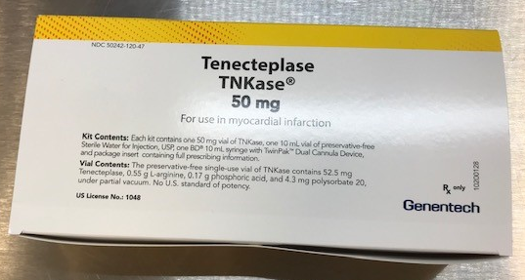
Tenecteplase Dosing
Stroke Provider calls pharmacy to order and mix* – need to have accurate patient weight!
Verify patient weight and dose of tenecteplase
Dual signature on MAR
TENECTEPLASE DOSING: 0.25mg/kg IV
Maximum of 25mg
Give IV Tenecteplase over 5 seconds
* Some hospitals may have the nurse reconstitute tenecteplase at the bedside.

Slide 18
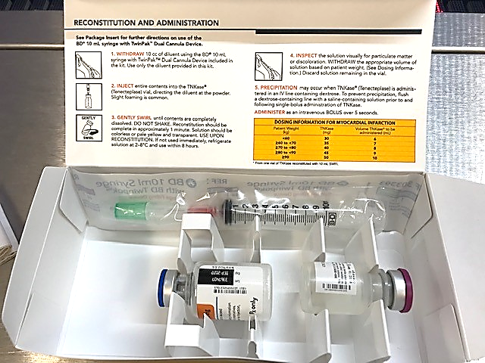
Tenecteplase Reconstitution
Use 10cc syringe with blunt fill needle to aseptically withdraw 10 mL of Sterile Water for Injection from the supplied dilutant vial.
DO NOT use Bacteriostatic Water for Injection, USP
Inject 10 mL into the tenecteplase vial. Direct the stream of dilutant into the powder.

Slide 19
Tenecteplase Reconstitution
Validate and Verify!
***WARNING***
DO NOT use MI dosing listed on the box!

Slide 20
Tenecteplase Reconstitution
3. Gently swirl until contents are completely dissolved.
DO NOT SHAKE.
Should be transparent, colorless, pale to yellow.
Final solution is 5mg/mL tenecteplase.
4. TIMEOUT: Max dose is 25 mg or 5mL for stroke.
Best practice: use a 5mL syringe to draw up final dose to avoid exceeding max dose of 25mg for stroke (5mL).

Slide 21
Tenecteplase Dosing
Inspect solution
Calculate dose according to patient’s weight 0.25 mg per kg (Use Providence weight-based dosing table – see next slide)
Dosing is rounded to the nearest 0.2 mL
Withdraw the appropriate dose/volume of tenecteplase solution based on weight
Max dose is 25 mg (5 mL) for stroke!

Slide 22
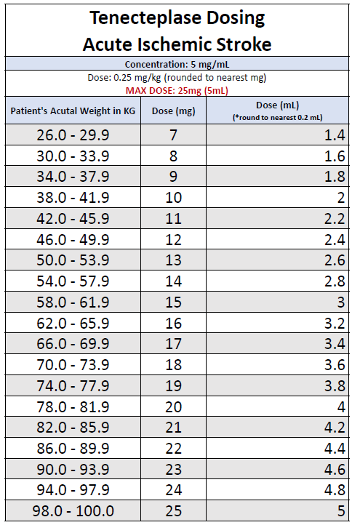
Tenecteplase Dosing
Providence is rounding dose to the nearest mg to simplify dosing.
Example 1: patient is 103 kg
103 kg x 0.25 mg = 25.75 mg
MAX DOSE IS 25 mg!
Give 25 mg or 5 mL
Example 2: patient is 67 kg
Concentration is 5 mg per mL
MAX DOSE IS 25mg!
Give 17 mg or 3.4 mL
Notes:
https://www.gene.com/download/pdf/tnkase_prescribing.pdf

Slide 23
Tenecteplase Dosing
ED Provider to order thrombolytic (order requires accurate patient weight)
Safety Check (3 ‘s in 30 seconds) = Time OUT prior to dose being given
(This is in addition to the 5 rights of medication administration)
1. Right Patient
2. Right Drug (Tenecteplase * or Alteplase)
3. Right Dose
TENECTEPLASE DOSING: Single Dose
Approx. 0.25mg/kg IV over 5 seconds
Maximum of 25mg
*Weight range dosing will be used.
See dosing table
DUAL SIGN OFF REQUIRED

Slide 24
Tenecteplase Dosing
Key Differences:​ Tenecteplase is NOT compatible with IV dextrose​ | Tenecteplase for Stroke:​ | Compare Alteplase:​
Weight based dosing​ | ~0.25 mg/kg​ | 0.9mg/kg​
Maximum dose​ | 25mg (5ml)​ | 90 mg (9ml bolus)​
Concentration​ | 5mg/mL​ | 1mg/mL​
Timeout/dual sign off?​ | Yes​ | Yes​
Bolus administration​ | Over 5 sec.​ Flush before and after with normal saline | Over 1-2 min​
Infusion post bolus?​ | No, bolus only​ | Yes for 1 hour​
Tenecteplase solution can precipitate if given in a line containing dextrose
Flush the line before and after tenecteplase with normal saline
Discard vial (expect at least 5ml of extra medicine in the discarded vial)

Slide 25
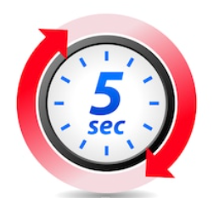
Tenecteplase Dosing

Slide 26
Before and
After Tenecteplase
Key Differences:​ ​ | Tenecteplase for Stroke:​ | Compare Alteplase:​
BP parameter​ | < 180/105​ | < 180/105​
Signs and symptoms to watch for after administration​ | Bleeding, angioedema, neuro changes​ | Bleeding, angioedema, neuro changes​
SNAP & VS frequency​ | q15min x 2hrs,​ q30min x 6hrs,​ q1hr x 16 hrs​ | q15min x 2hrs, ​ q30min x 6hrs, ​ q1hr x 16 hrs​
Brain bleeding risk​ | Equivalent or less than alteplase²⁻⁵​ | 6%​

Slide 27
After Tenecteplase
Do NOT give any anticoagulant or antiplatelet agents for 24 hours after thrombolytic therapy
AVOID placing any lines or tubes that are not needed.
DELAY placing necessary lines and/or tubes for at least 60 minutes post thrombolytic
Monitor for bleeding

Slide 28
Acute Stroke Treatment
Faster treatment saves lives and reduces disability!
For every 15 minutes saved:
Fewer patients die
Fewer patients bleed
More patients go home
More patients are walking independently at discharge
Saver et al. JAMA 2013 Vol 309, 23

Slide 29
Tenecteplase for Stroke
THANK YOU!

Slide 30
References
Powers WJ, Rabinstein AA, Ackerson T, et al. Guidelines for the Early Management of Patients With Acute Ischemic Stroke: 2019 Update to the 2018 Guidelines for the Early Management of Acute Ischemic Stroke: A Guideline for Healthcare Professionals From the American Heart Association/American Stroke Association. Stroke. 2019;50(12): https://www.ahajournals.org/doi/epub/10.1161/STR.0000000000000211 ​
Burgos AM, Saver JL. Evidence that Tenecteplase Is Noninferior to Alteplase for Acute Ischemic Stroke: Meta-Analysis of 5 Randomized Trials. Stroke. 2019;50(8):2156-2162. https://www.ahajournals.org/doi/epub/10.1161/STROKEAHA.119.025080​
Katsanos AH, Safouris A, Sarraj A, et al. Intravenous Thrombolysis With Tenecteplase in Patients With Large Vessel Occlusions: Systematic Review and Meta-Analysis. Stroke (00392499). 2021;52(1):308-312. https://www.ahajournals.org/doi/epub/10.1161/STROKEAHA.120.030220​
Coutts SB, Berge E, Campbell BC, Muir KW, Parsons MW. Tenecteplase for the treatment of acute ischemic stroke: A review of completed and ongoing randomized controlled trials. International journal of stroke: official journal of the International Stroke Society. 2018;13(9):885-892. https://doi.org/10.1177/1747493018790024​
Zitek T, Ataya R, Brea I. Using Tenecteplase for Acute Ischemic Stroke: What Is the Hold Up? Western Journal of Emergency Medicine: Integrating Emergency Care with Population Health. 2020;21(2):199-202. https://doi.org/10.5811/westjem.2020.1.45279​
McKinney,J., Treible, L., Vinodh, D., Kalp, M., Beecher, J., Nakajima, S., Curley, T. Stroke Treatment With Tenecteplase Improves Door-To-Needle Time. Stroke. 2021;52:AP28 https://www.ahajournals.org/doi/10.1161/str.52.suppl_1.P28 ​
Mechanical thrombectomy: Stent retrievers vs. aspiration catheters https://www.sciencedirect.com/science/article/pii/S0010865016000060
Genetech https://www.activase.com/ais/dosing-and-administration/reconstituting.html
https://www.tnkase.com/dosing-and-administration/dosing-administration-and-reconstitution.html#:~:text=INJECT%20entire%20contents%20(10%20mL,stand%20undisturbed%20for%20several%20minutes.&text=GENTLY%20SWIRL%20until%20contents%20are,DO%20NOT%20SHAKE.
Notes:
Added AHA nursing ref

